Slide 1
Configure your build with tsconfig.json
Step 1: define a tsconfig file on root :
Step 2: run TSC on root :
tsc -init
tsc
{
"compilerOptions": {
"outDir": "dist"
},
"include": ["src/**/*"],
}
The build
folder
Step 3: run node on dist folder
node dist/Main.ts
What is included
In the build

Slide 2
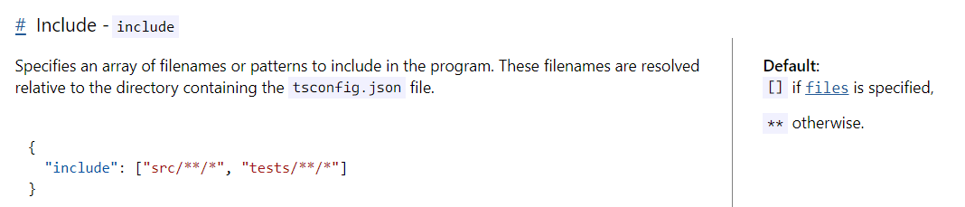
Learn to understand documentation
https://www.typescriptlang.org/tsconfig#include
Description and example
Default value if not specified

Slide 3

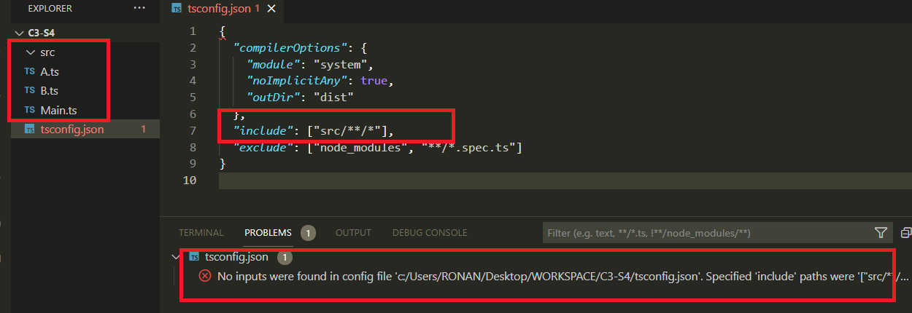
ACTIVITY 1
// 1 - Open the project : you should see the following error : “no input found in config file…
// 2 –Fix this code by moving the 3 files into the /src folder
// 3 – Run TSC and run NODE dist/Main.ts

Slide 4
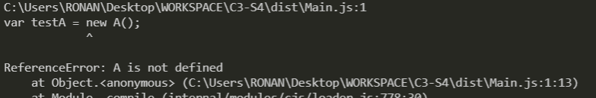
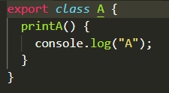
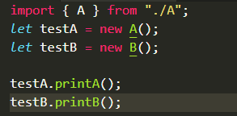
Export and Import your classes
Typescript share the same idea of modules (export/import…) than JS and NodeJS
Class A need to be exported on A.ts and imported on Main.ts

Slide 5
ACTIVITY 2
// Fix the code to avoid errors related to the import/export of modules

Slide 6
While developing you can also use ts-node
Step 1: install ts-node (if not done yet)
Step 3: run ts-node on root :
npm install -g ts-node
ts-node src/Main.ts
Step 2: check you package is installed
BUILD + RUN at the same time
npm list -g
C:\Users\LENOVO\AppData\Roaming\npm
├── @vue/cli@5.0.8
├── ts-node@10.9.1
└── typescript@4.9.5

